Slide 1
Applied Logistic Regression:
Detecting Chronic Kidney Disease Risk
IDS.506 - Robert Minh Duc Bui - mbui7@uic.edu

Slide 2
Executive Summary
We can develop a logistic regression model that prioritises detecting high-risk subjects for clinical CKD testing.
Challenges include:
Dataset imbalance - due to disease prevalence being less than 50%.
Collinearity - due to many recorded variables being derivatives of each other.
Final model at-a-glance:
Elastic-Net Logistic Regression
Dummy variables + low variance filter + normalization + upsampling
Quick Performance Metrics compared to uncalibrated Logistic Regression:
Balanced Accuracy: bACC = 0.8439 (+45% lift)
Sensitivity: TPR = 0.9231 (+446% lift)

Slide 3
Research Mission
To develop a model that:
Combines all the possible risk factors (first 33) to measure overall risk to
Predict CKD.
Variables need not cause CKD - strictly associative relationship.
Pitfalls:
Population is not representative of US public. Model is theoretical and cannot be used in real decision-making.

Slide 4
Dataset Introduction
Source: CDC’s National Center for Health Statistics dataset on CKD.
Collection Methods:
Target Variable (CKD): urine test.
Columns A to J (demographic-related): subject-provided answers.
Columns K to V (clinical measurements): collected during physical exam.
Columns W to AH (health histories): self-reported.

Slide 5
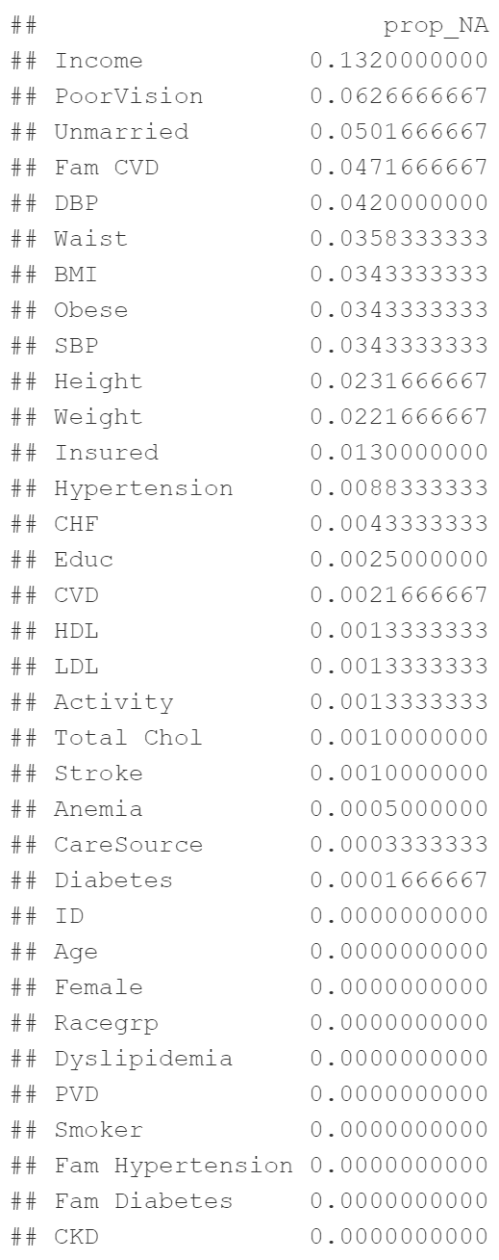
Import Preprocessing
Dealing with NAs:
Filtering out NAs for CKD (original dataset validation set)
Filtering out all NAs for other values.
After removing NAs:
Dataset is trimmed from 6000 training rows to 4135 rows (69% of original).

Slide 6
Import Preprocessing #2
Columns to be removed:
ID : contains no information.
Weight + Height : collectively represented by BMI. Removed to prevent collinearity.
TotalChol : is a simple sum of two other variables HDL + LDL. Removed to prevent collinearity.

Slide 7
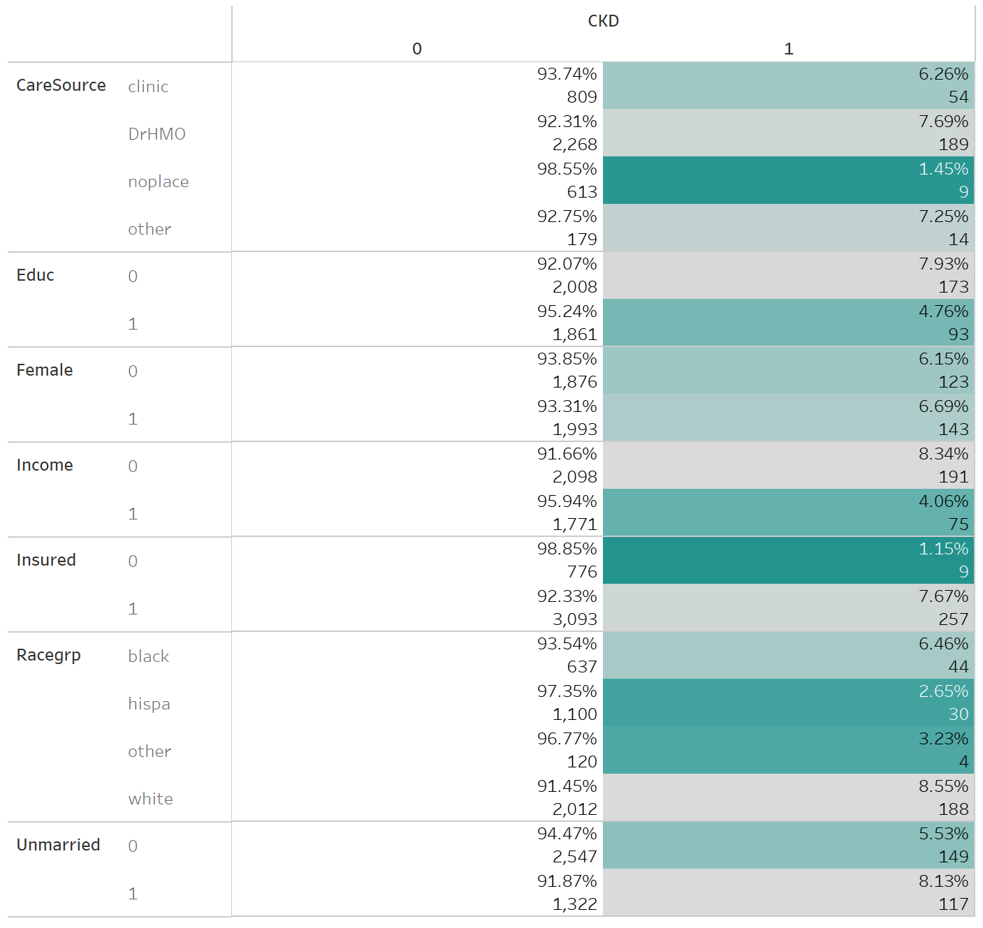
Exploratory Data Analysis #1 - Non-Numerics

Slide 8
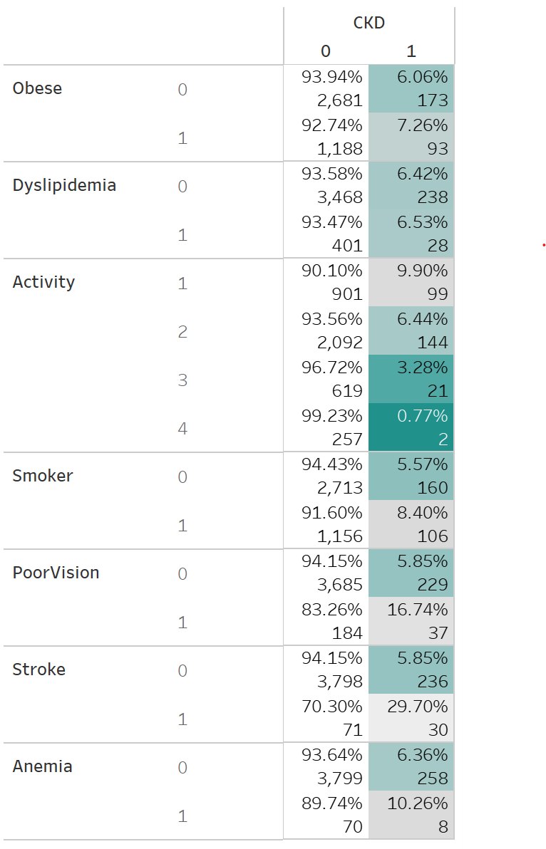
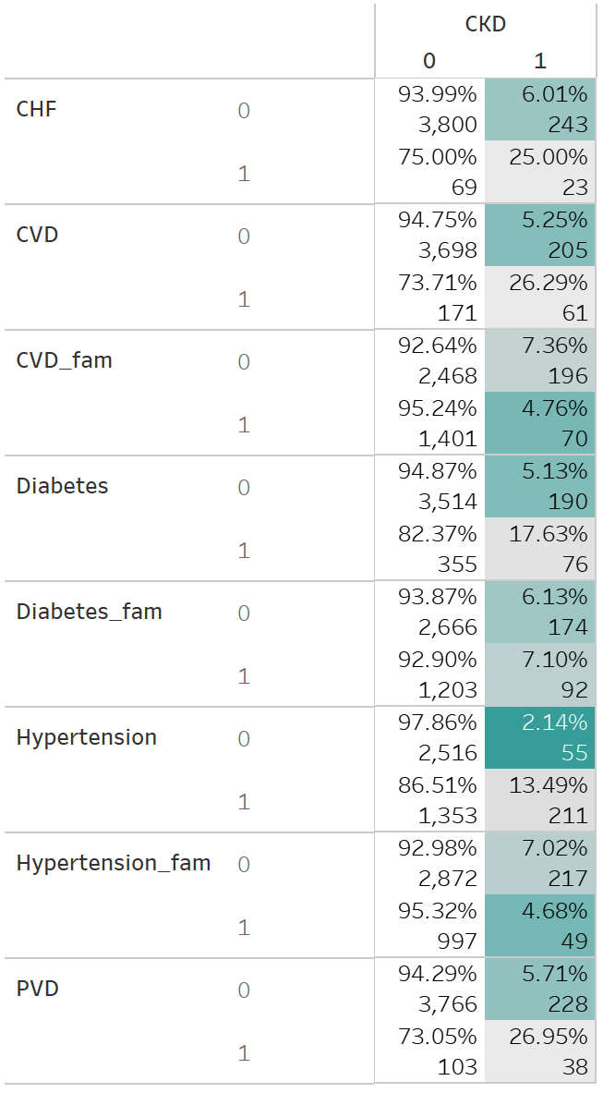
Exploratory Data Analysis #2 - Non-Numerics
Notes:
Hypertension, CHF, CVD, Diabetes, and PVD are strong comorbidities with CKD here.

Slide 9
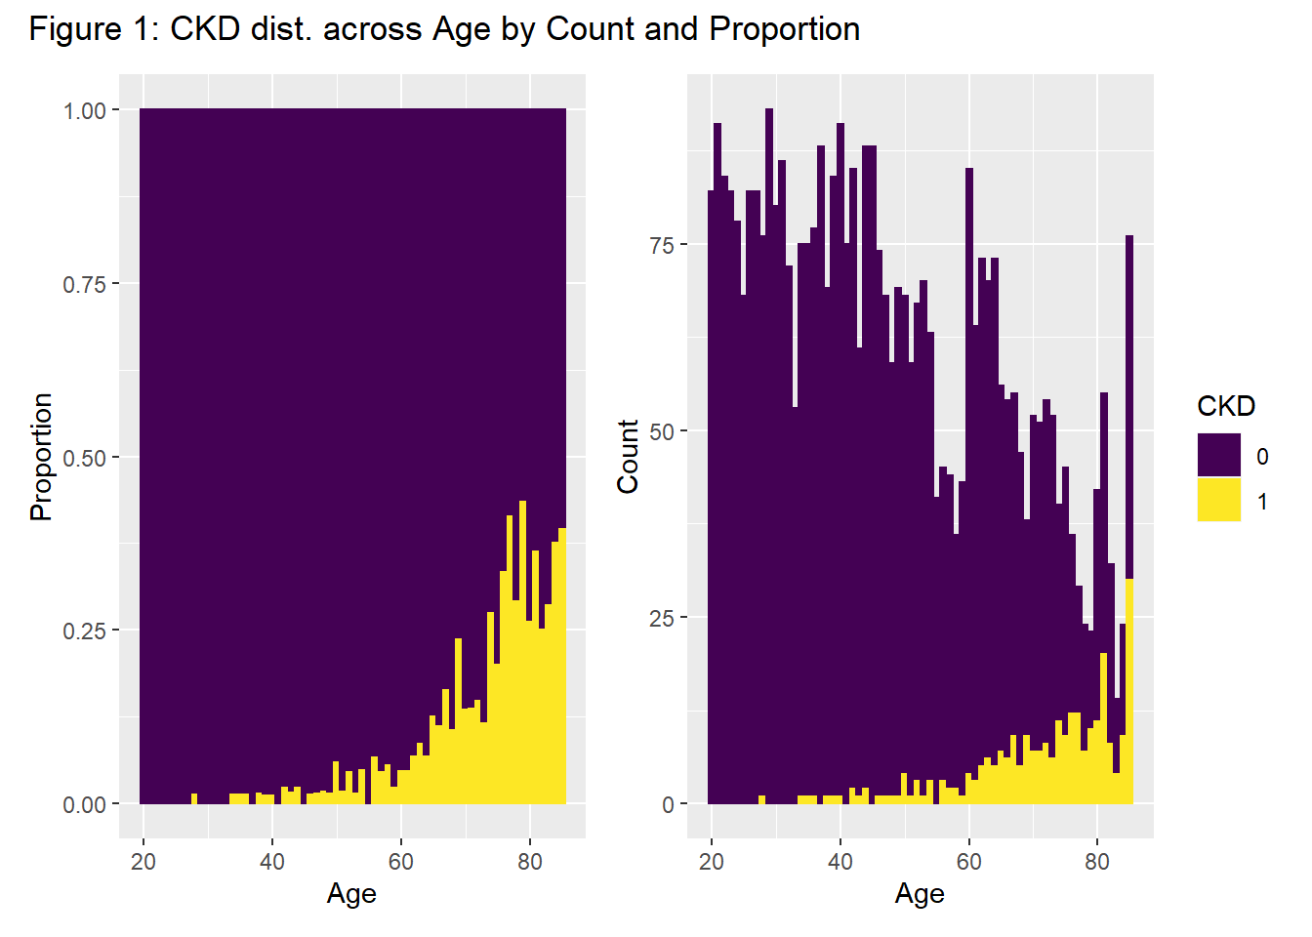
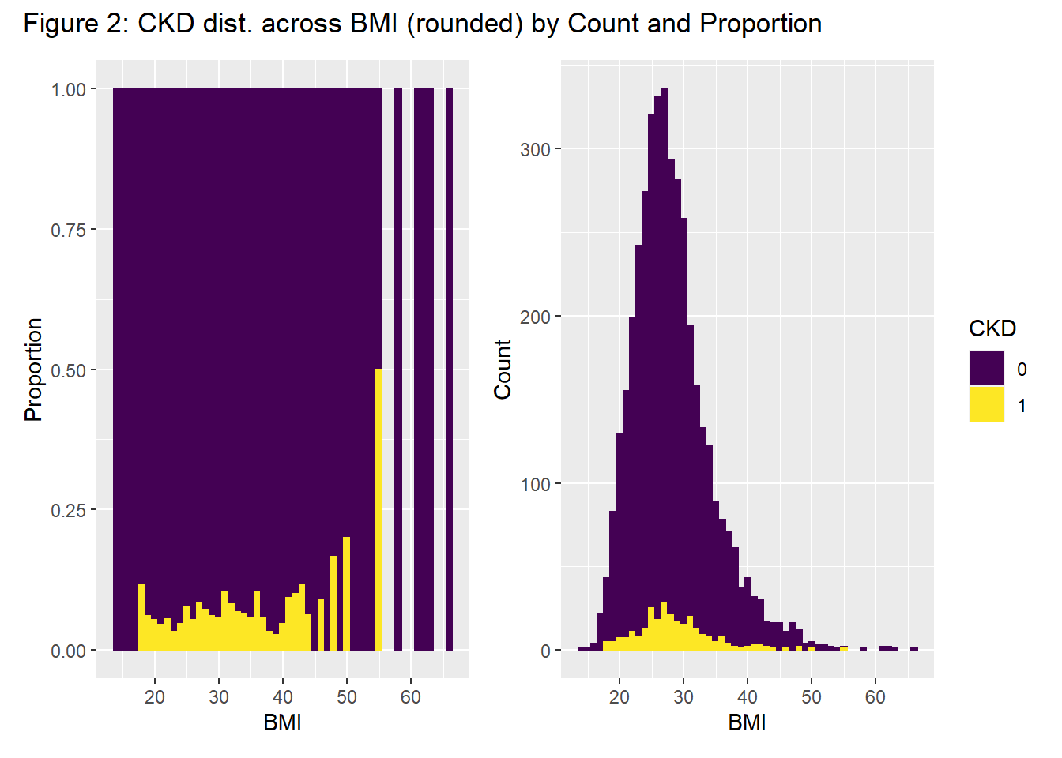
Exploratory Data Analysis #3 - Numerics
Notes:
Age exhibits a strong relationship with CKD here, from the proportional plot.

Slide 10
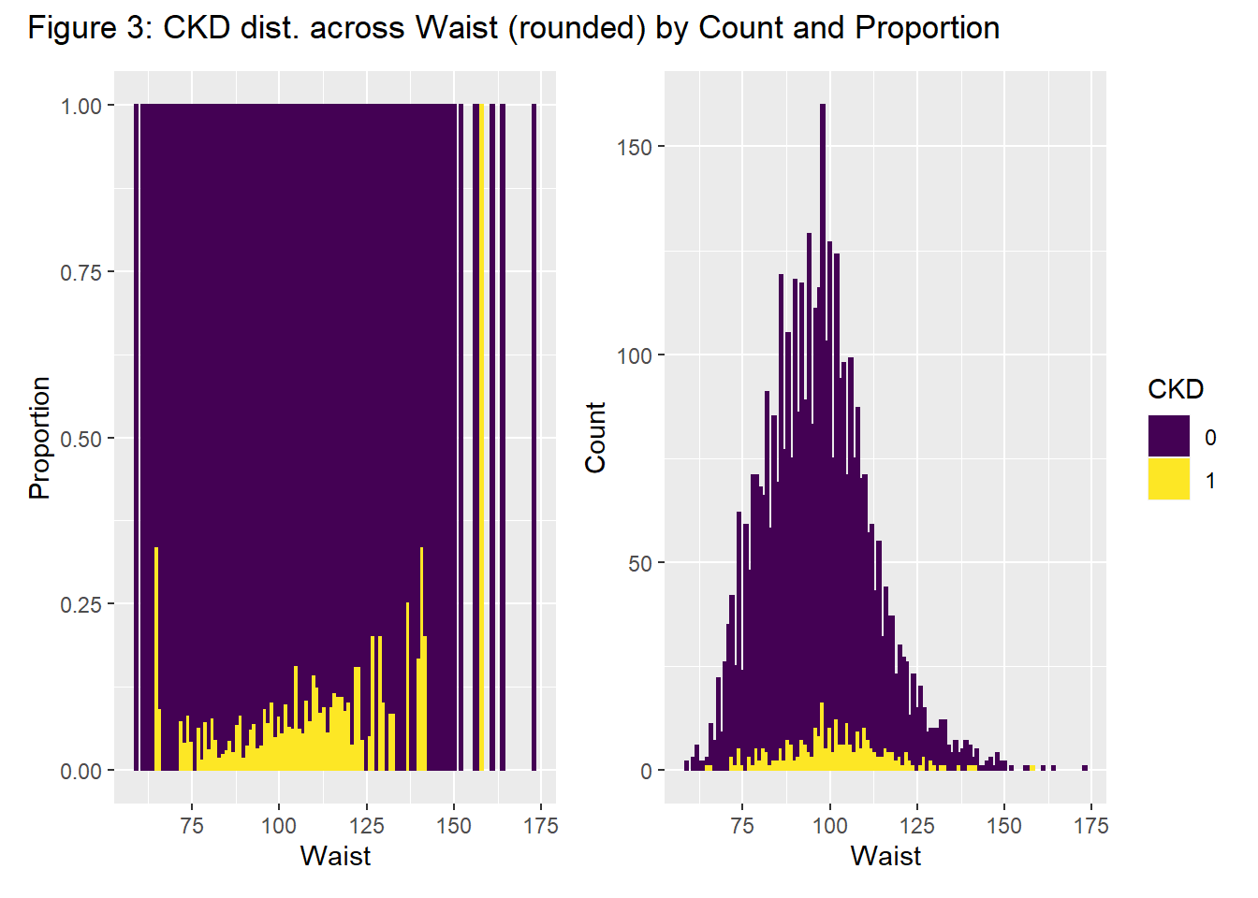
Exploratory Data Analysis #4 - Numerics

Slide 11
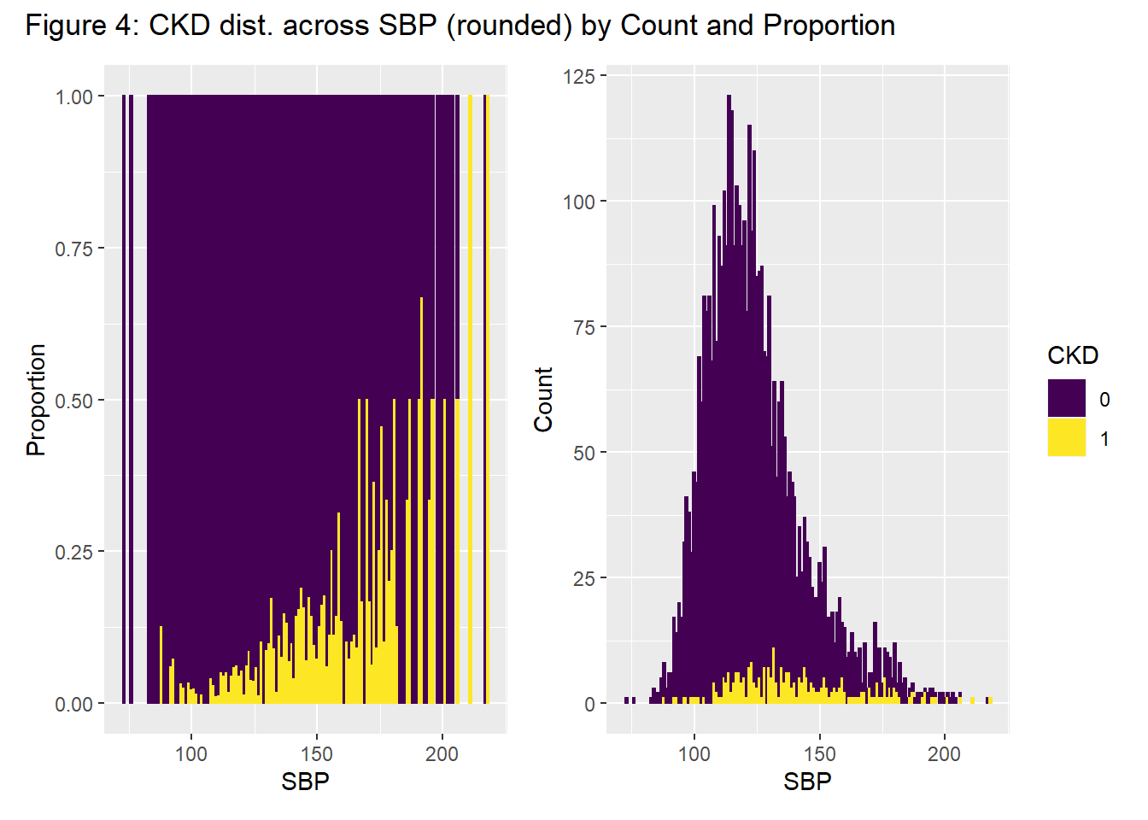
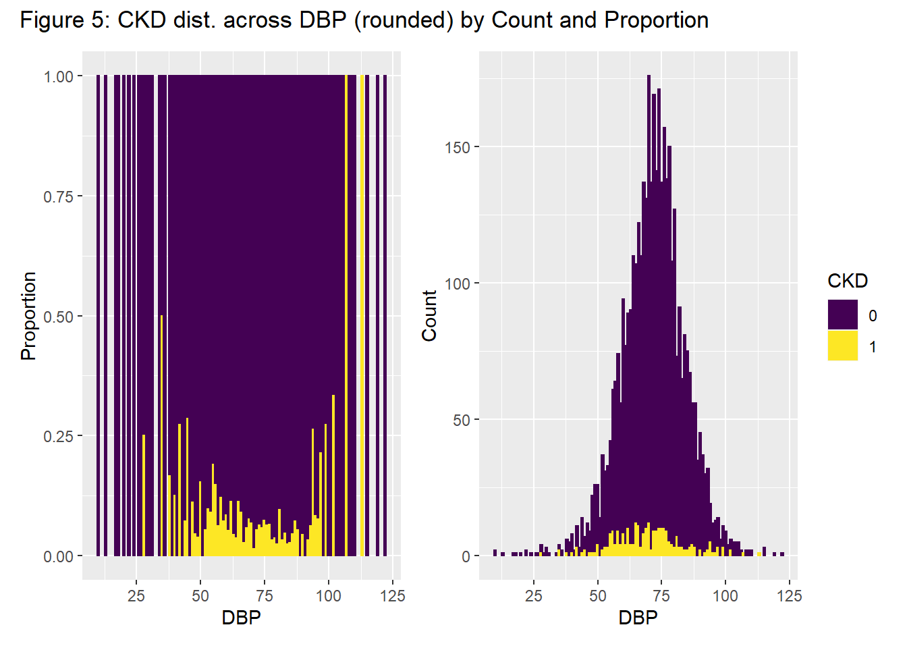
Exploratory Data Analysis #5 - Numerics

Slide 12
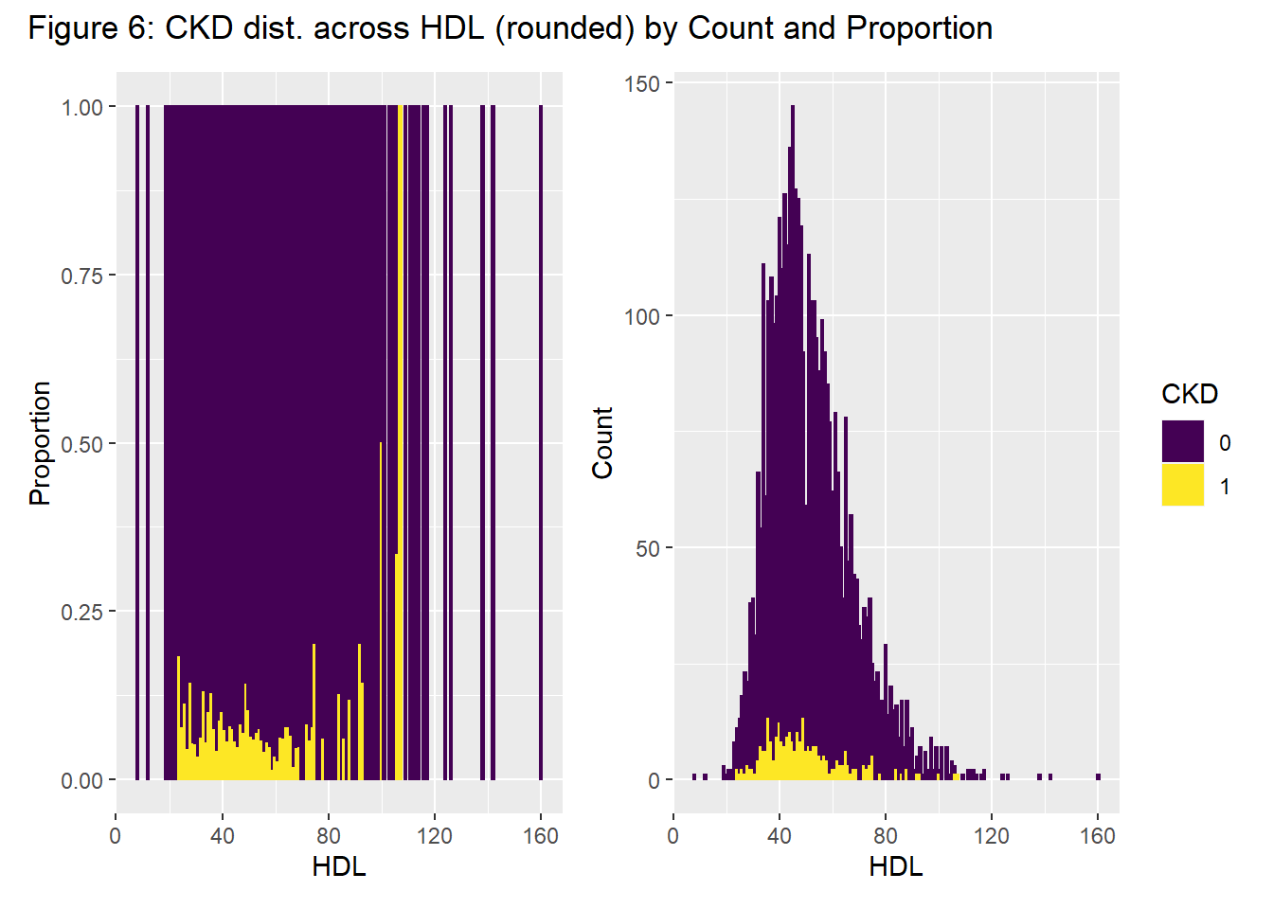
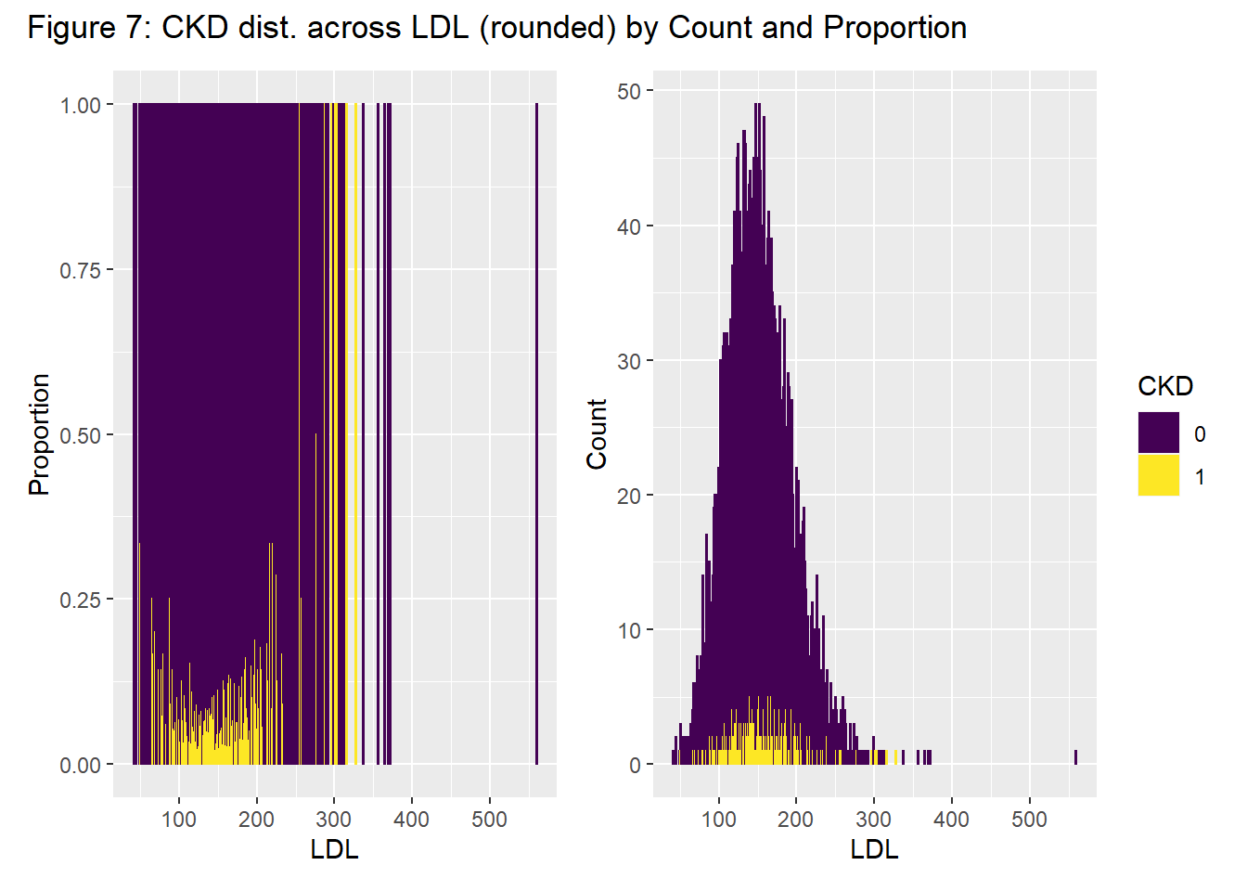
Exploratory Data Analysis #5 - Numerics

Slide 13
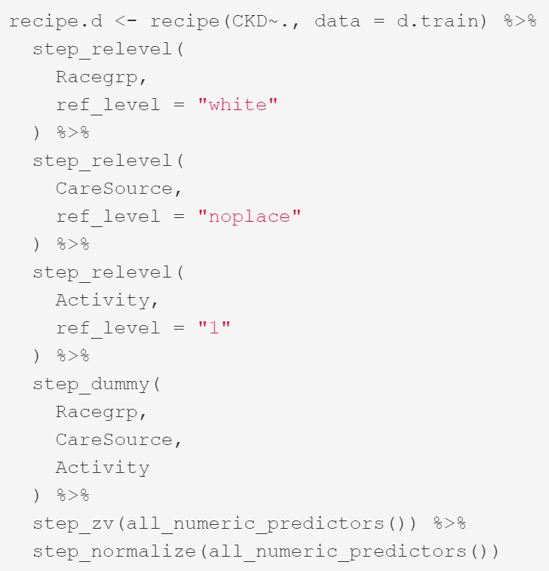
Modeling Preprocessing
Processing steps:
Set Reference levels for Dummy variables
Create Dummy variables
Filtering for no-variance predictors
Normalizing all numerics (mean 0 var 1)

Slide 14
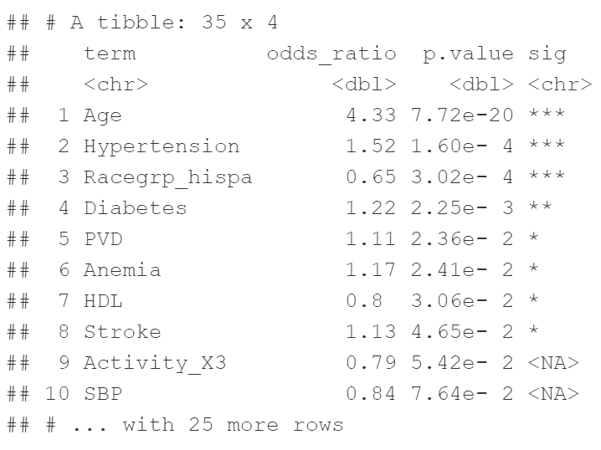
Experimental Model #1: Base GLM LogReg

Slide 15
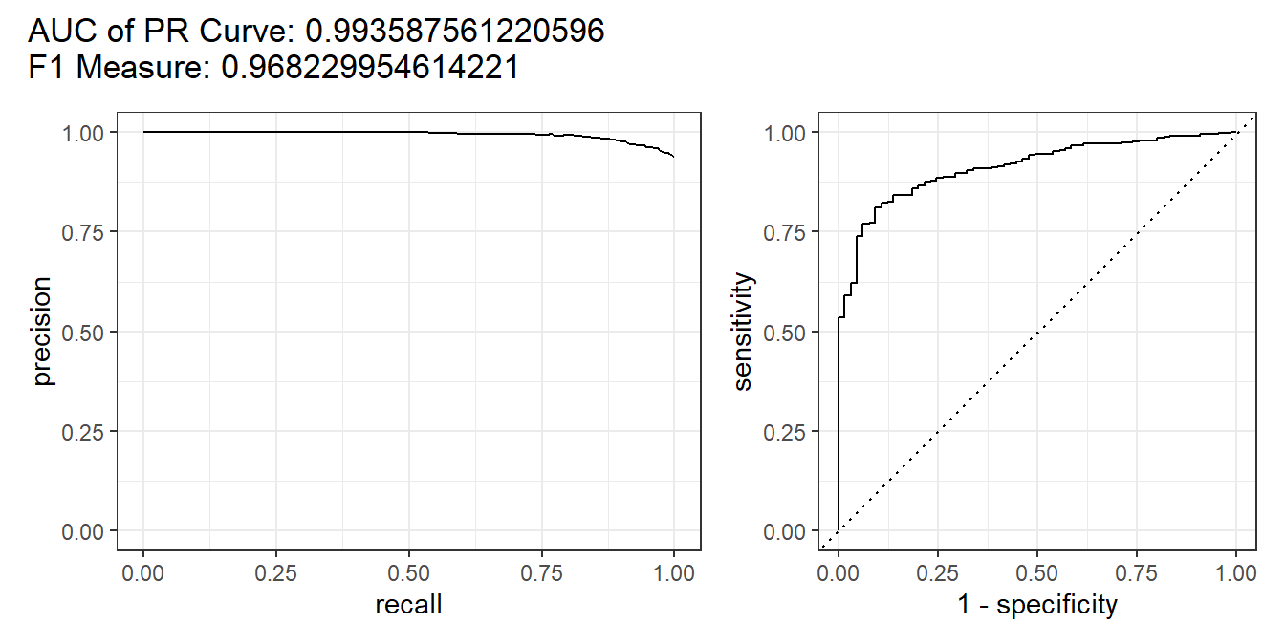
Experimental Model #1: Base GLM LogReg
Unadjusted Metrics:
Notes:
This performance is the Red Herring of this entire process: misleading, a waste of time, and concealing the truth of the model.

Slide 16
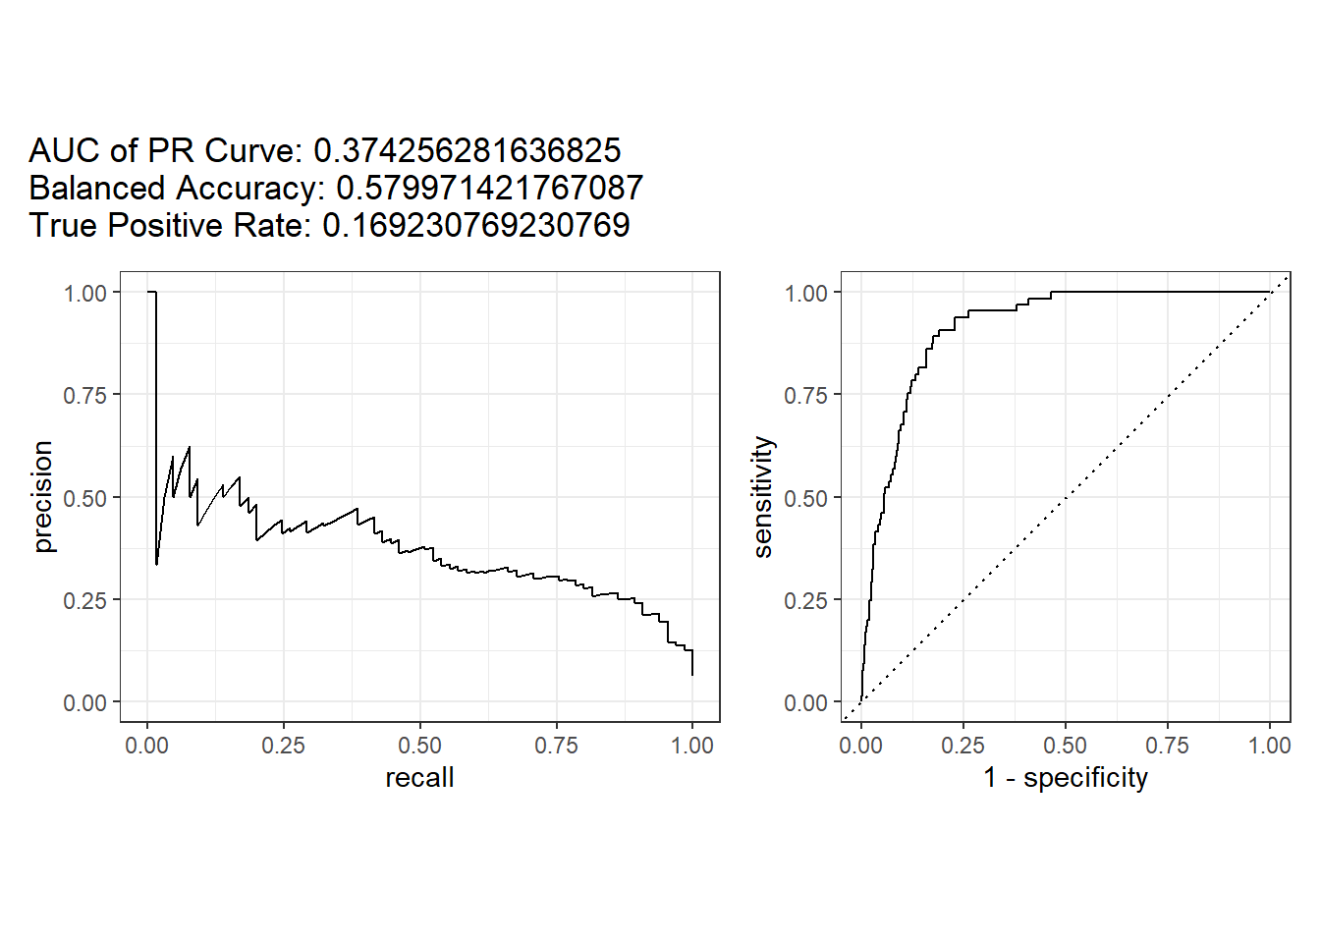
Experimental Model #1: Base GLM LogReg
Adjusted Metrics:

Slide 17
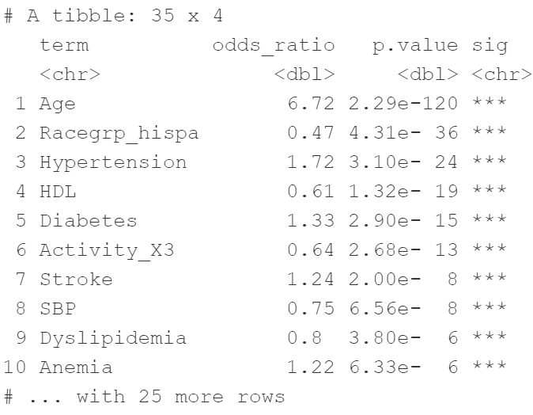
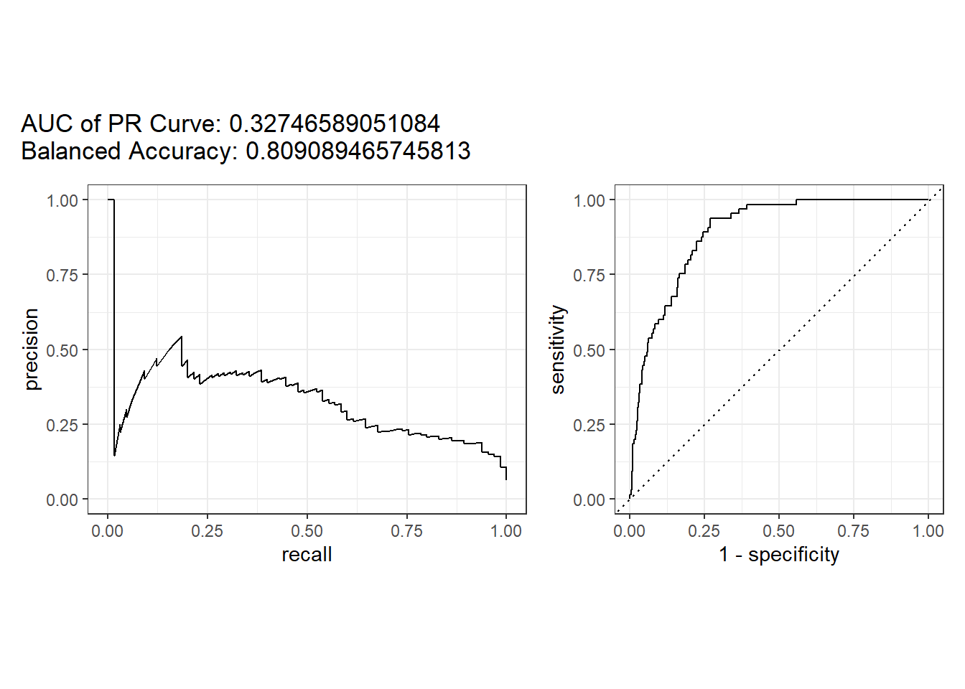
Experimental Model #2: Downsampled GLM
Adjusted:

Slide 18
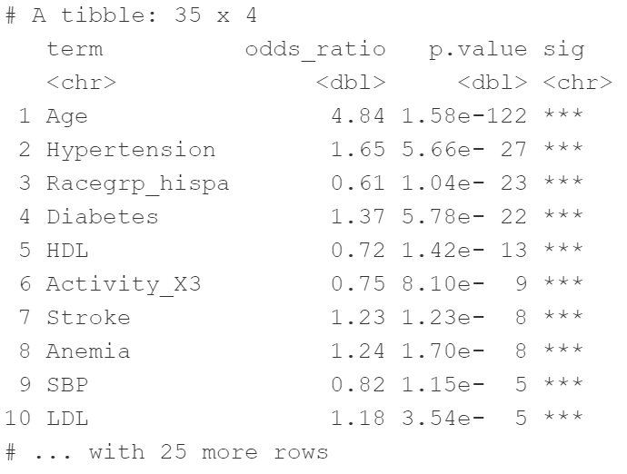
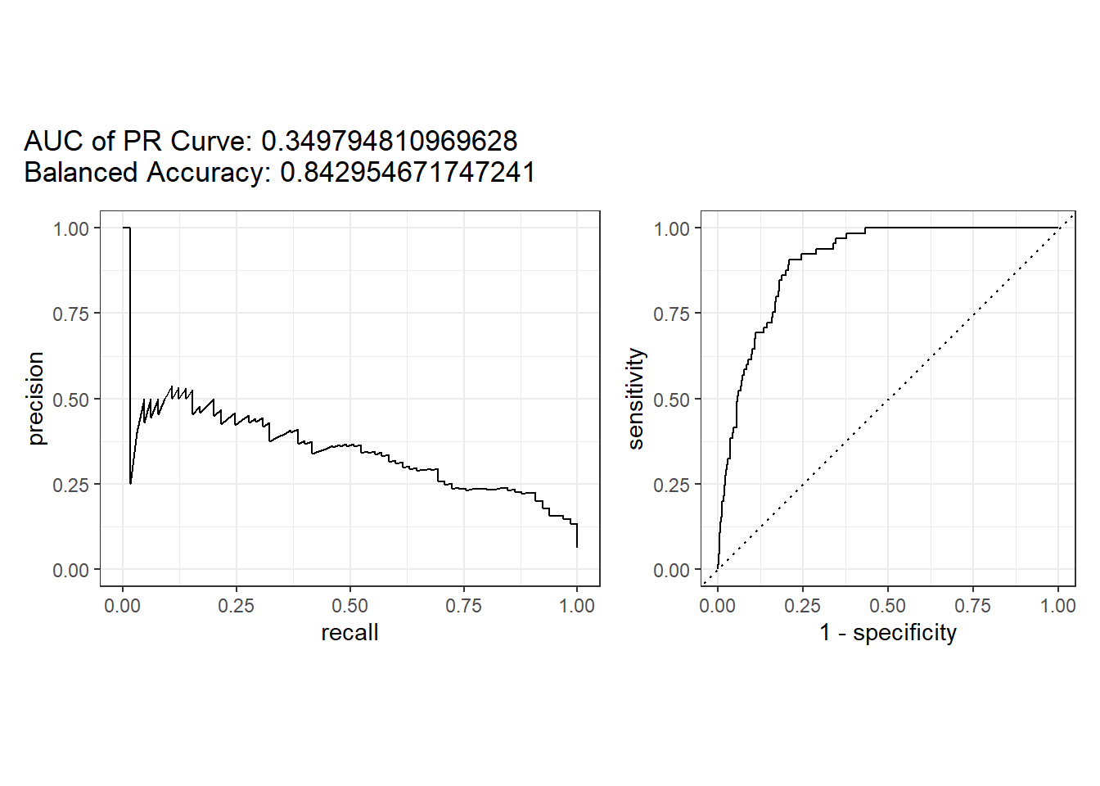
Experimental Model #3: Upsampled GLM
Adjusted:
Notes:
Note that statistical significance here is no longer interpretable as the upsampling process has exaggerated the true sample size available in the dataset, which affects calculations of the p-value.

Slide 19
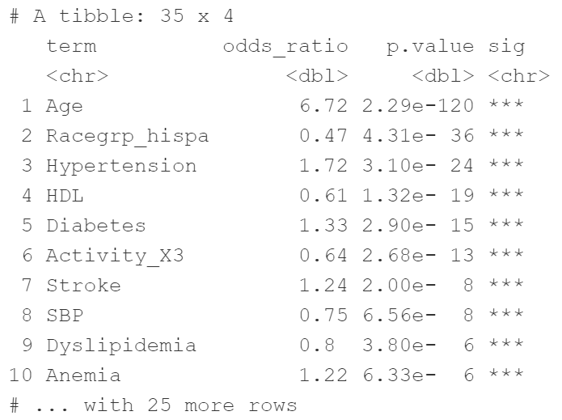
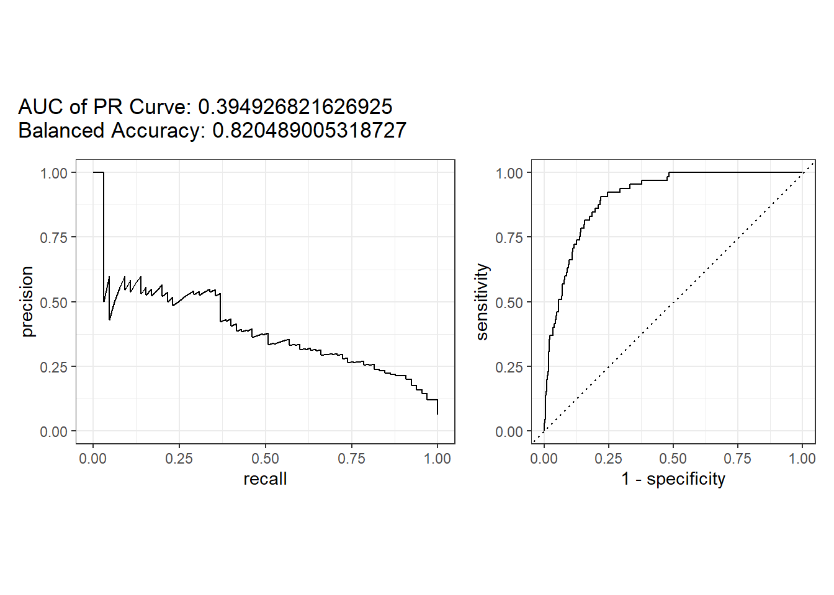
Experimental Model #4: SMOTE GLM
Adjusted:
Notes:
“… SMOTE first selects a minority class instance a at random and finds its k nearest minority class neighbors. The synthetic instance is then created by choosing one of the k nearest neighbors b at random and connecting a and b to form a line segment in the feature space. The synthetic instances are generated as a convex combination of the two chosen instances a and b.” _ Imbalanced Learning: Foundations, Algorithms, and Applications, Yunqian Ma, Haibo He 2013

Slide 20
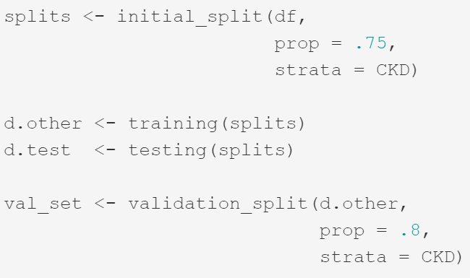
Advanced LogReg Modeling: CV-tuning
Data splits:
d.test : final testing set (25% of total data)
d.other : training sets for CV, split 80/20 5-fold.
CV-training folds (60% of total data)
CV-validation folds (15% of total data)
Resampling at all steps are stratified to preserve original balance.

Slide 21
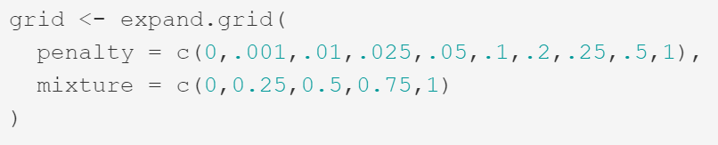
Advanced LogReg Modeling: CV-tuning
Model: glmnet-based logistic regression tuned for Balanced Accuracy (bACC)
Tuning parameters:
penalty : regularization term used in fitting.
mixture : regularization type
0 = Ridge Regression
1 = LASSO Regression
In-between values are Elastic-Net Regressions.

Slide 22
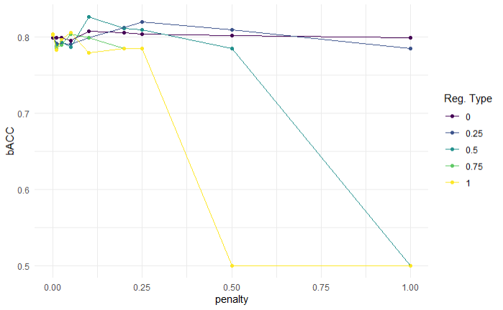
Advanced LogReg Modeling: CV-tuning
CV grid search results: mixture = 0.5 (elastic-net), penalty = 0.1

Slide 23
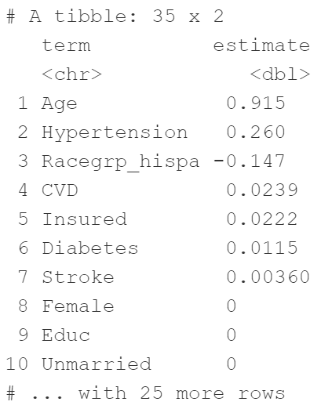
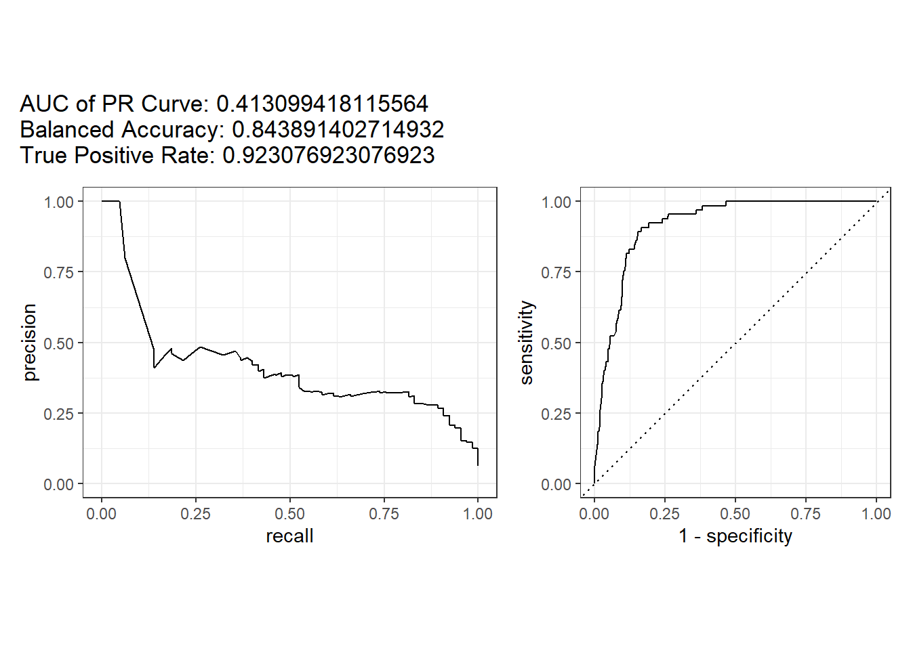
Advanced LogReg Modeling: CV-tuning
Final Results:
Notes:
Note that the elastic-net model, with an aggressive penalty term, has reduced most variables to a coefficient of 0 in the final model, creating a very simplified model.

Slide 24
Final vs. Initial Models
Notes:
Lift ratio: bACC_final/bACC_initial = 0.8439/0.5800 = 1.455
TPR_final/TPR_initial = 0.9231/0.1692 = 5.456

